Slide 1


HACKATHON - 2021
TEAM KNIGHTS
Dasun (Team leader)
Arun
Rajitha
Fathima
Thamina

Slide 2


Content
Introduction
Tools

Slide 3
INTRODUCTION
The task is to establish educate monitoring for the application and identify the failure points of it through monitoring and diagnostics.
Prevention of recurrence has been suggested for the root causes that have been identified for the failure.
Temporary work arounds have been built to alleviate the issues found.

Slide 4
TOOLS

Slide 5
CODEIGNITER
Codeigniter has been used to monitor.
It is a powerful PHP framework with a very small footprint.
With MVC architecture it can separate input processing and of any application.
And it offers vast libraries to connect the database operations.

Slide 6
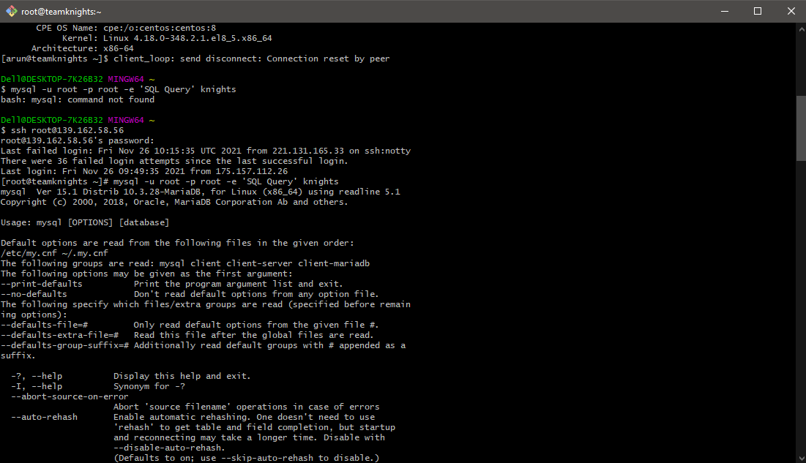
CREATE DATABASE

Slide 7
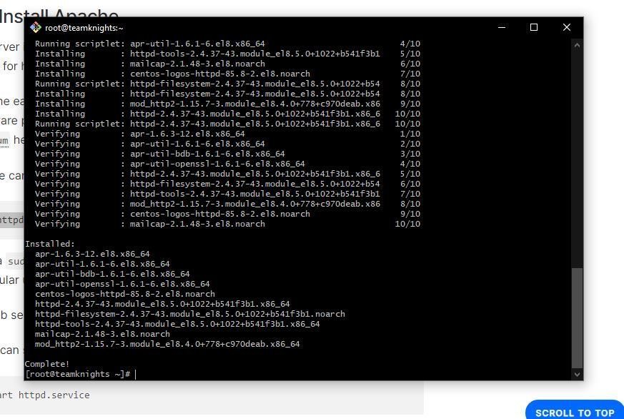
Install Apache

Slide 8
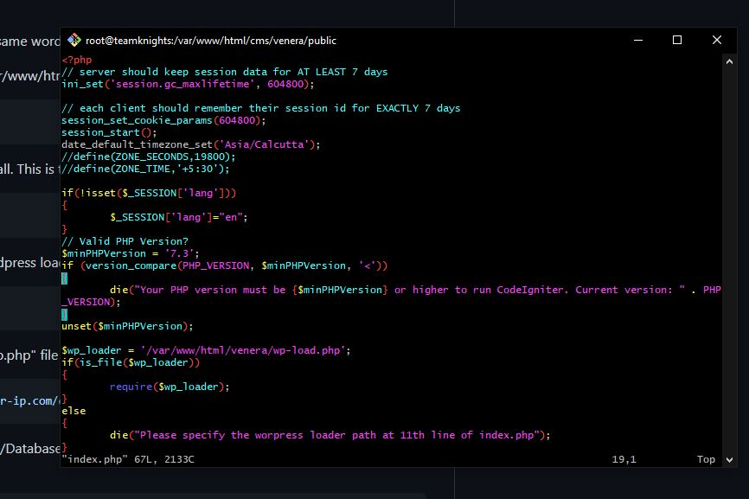
The file open using vim editor

Slide 9
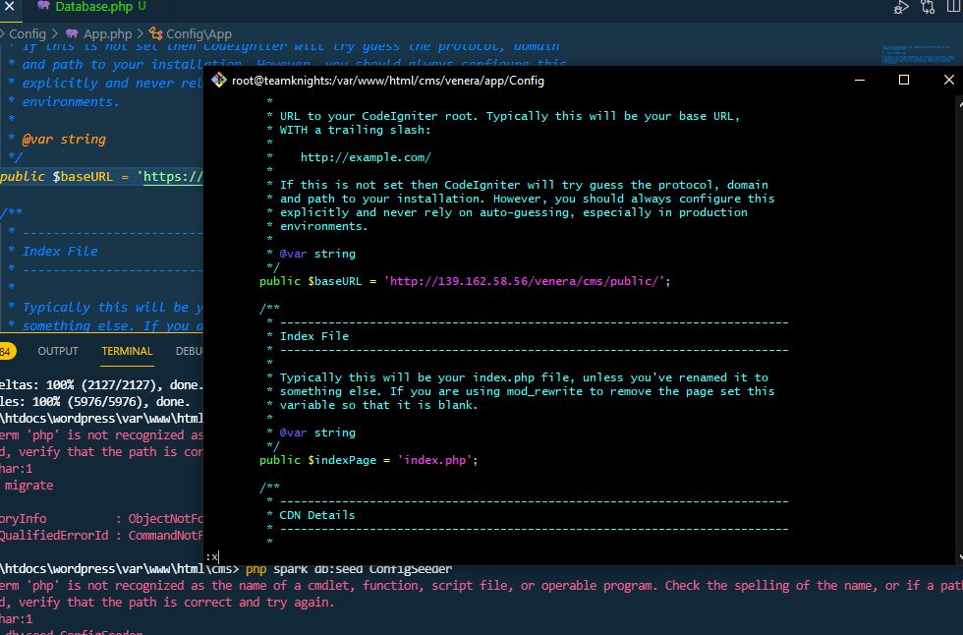
Changing the Case URL with our IP

Slide 10
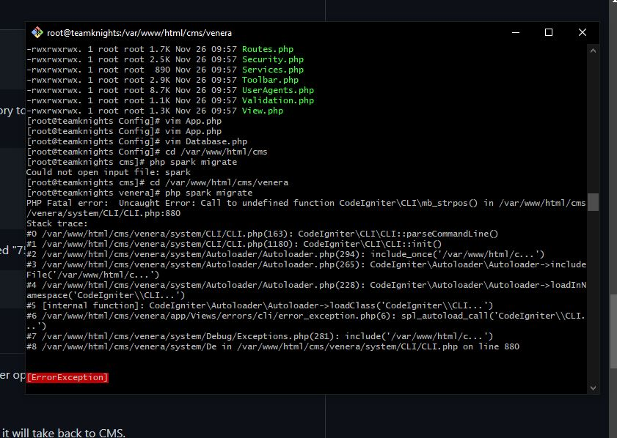
Edited Files

Slide 11
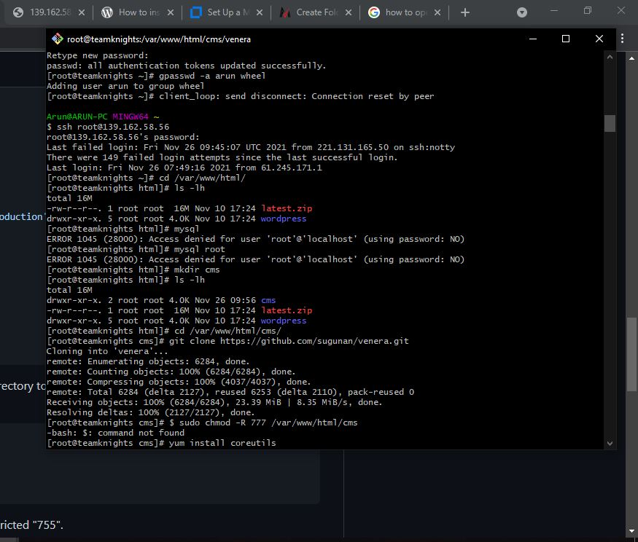
Cloning the application

Slide 12
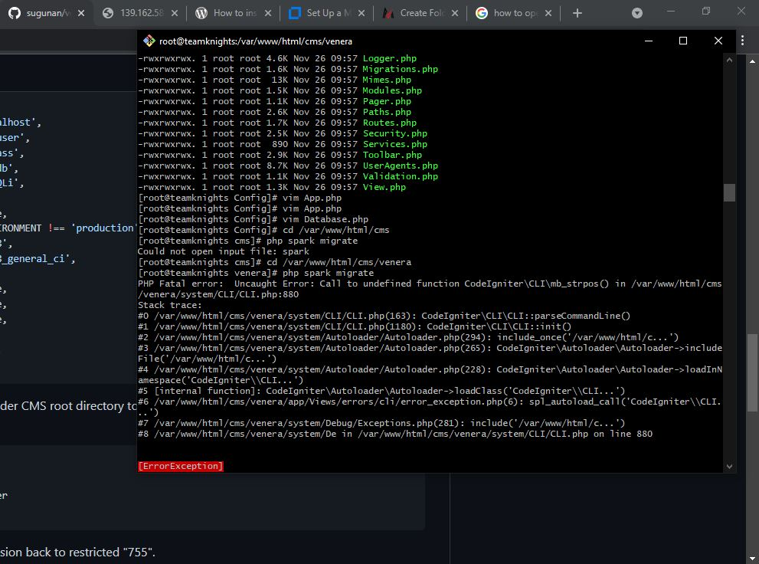
Migrate Data

Slide 13
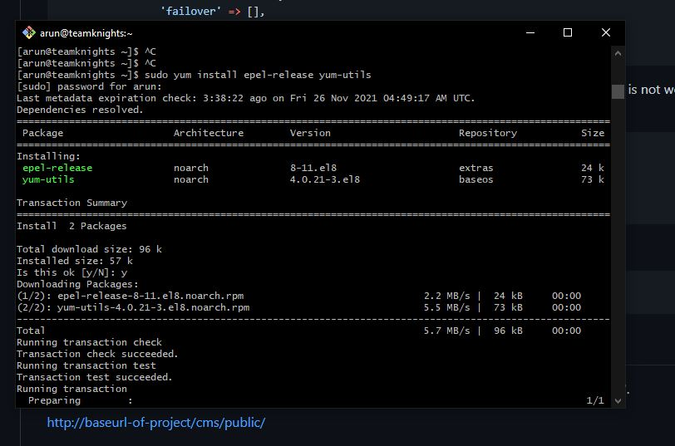
PHP installation

Slide 14
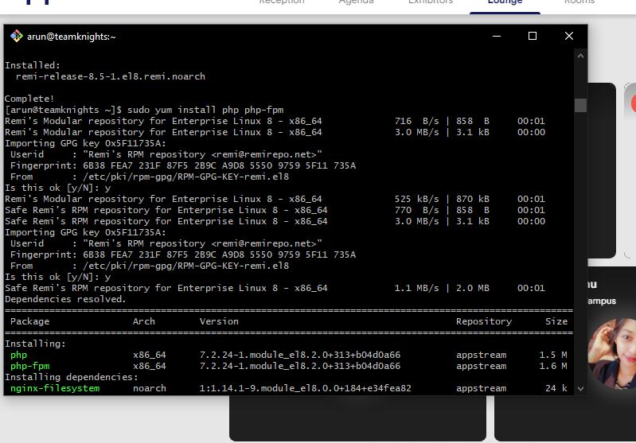
Changing the Case URL with our IP

Slide 15
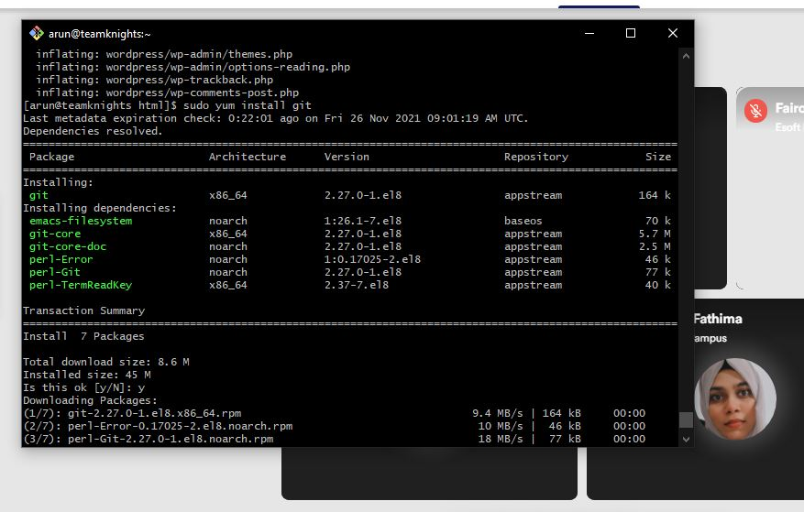
Install GIT

Slide 16
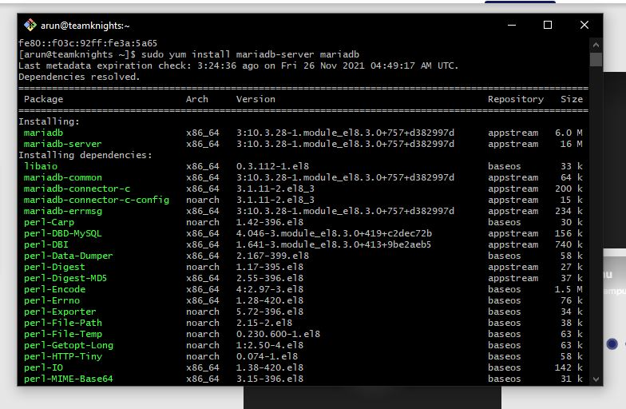
Install MYSQL

Slide 17
THANK YOU..!

